Slide 1
Almabridge Building Bridges Across Generations
2021-CS-75 Muhammad Shahzaib Ijaz 2021-CS-82 Muhammad Abdullah 2021-CS-175 Fatima Awais 2021-CS-201 Zoya Naveed
Project Supervisor Dr. Faiza Iqbal
Group ID G-4

Slide 2
Introduction: Purpose of the Project
Importance of Mentorship
Departmental Benefits
The powerful combination of mentorship and a supportive community can create an ecosystem that fosters growth for both entities.
Mentorship and community building are the heart of AlmaBridge. It connects experienced alumni with students, fostering guidance and support that bridges the gap between academic learning and industry experience
Almabridge will foster a stronger connection between student alumni and their departments, leading to increased departmental pride and support.
This can translate into more alumni donations, internship opportunities, and a more vibrant university image.
Source of Inspiration
Win-Win Situation
With Almabridge, we want to empower students to see themselves in the achievements of our alumni.
Witnessing the success of those who walked these same halls will shatter the illusion of unattainability.
Almabridge flips the script on project collaboration.
Alumni can easily post project needs, while students can discover and apply for relevant outsourcing and community work opportunities.
This creates a win-win situation: a trusted pool of talent for alumni and valuable project experience for students.

Slide 3
Existing Systems
 | How they work? | Limitations and gap | How Almabridge covers this gap?
Alumni Offices | Maintaining data on alumni and frequently sharing newsletters and upcoming events in the university via emails. E.g. UET LHR Alumni Office (38,000+ alumni data available), PU Alumni Office | The alumni office has not been able to fill the void because there is a lack of data gathering and maintaining up-to-date data on the alumni. | While fresh grads can offer their primary and secondary emails and contacts during registration to stay in touch, live scraping from social media can be a useful method to update alumni data.
Social Media | Most institutions such as LUMS, FAST, and UET have WhatsApp groups or Facebook pages to keep students and alumni engaged. LUMS Alumni Connected (LinkedIn) and Old Students Association of FAST NU (OSAF) are great examples. | Inactivity of members of these groups and irrelevant content sharing are limiting its impact and veering away from the purpose. | User activities will be monitored. An email or reminder notification will be sent to a user who has not been active in a long period of time. A chatbot or moderator will ensure that no-one is shared with irrelevant content or spammed.
Societies and Communities | Working with seniors and developing positive relationships with team leaders can be helpful for students in long run. Xnews (UET) and SOFTEC (FAST) are primary examples of such societies | Societies are made up of students with diverse interests and backgrounds. Furthermore, power dynamics might have unfavorable outcomes. | Through the system, students and alumni in related fields and having similar interests will be connected. Mixing different groups will not occur.
Meetups and Gatherings | Universities host annual gatherings where alumni are cordially welcomed (Alumni Reunion 2023 by UET). These gatherings can provide excellent opportunities for networking and relationship building, mentorship & referrals. | Gathering these students and alumni is a difficult task due to time and location constraints. | Instead of meeting or congregating in person, users can consider webinars and online meetings. This facilitates easy and convenient one-on-one discussion.
Portals and Websites | They enable mentorship programs, and offer a searchable directory for networking. Career services provide expert advice and include job boards, counseling, and seminars. For example Website: https://alumni-cse.uet.edu.pk/ Portal: UMT Alumni access portal | They fall short in connecting students and alumni due to inadequate promotion, and limited functionality. Low engagement and insufficient support further makes it less effective. | Well-commercialized and proper marketing so it reaches the targeted audience. Providing a better user experience by being effective and user-friendly. Make certain that the efforts of alumni are valued and recognized.

Slide 4
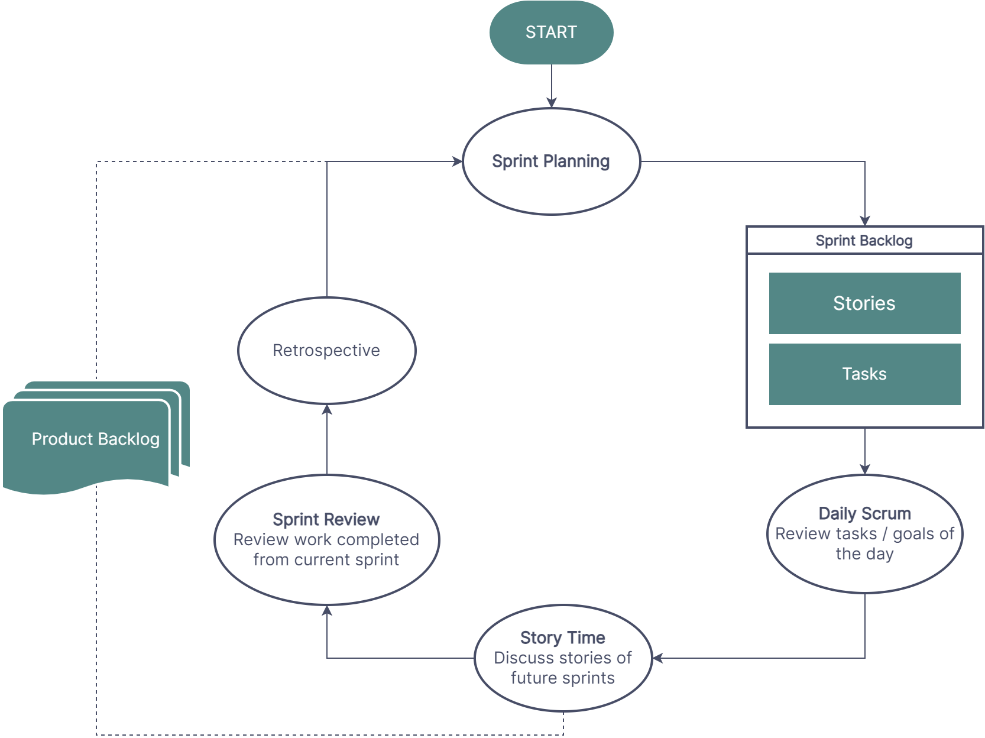
Methodology – Scrum Workflow (Tentative)
Product Backlog
Daily Scrum
A list of all the features and functionalities to decide which items to work on during each sprint.
A short meeting we will holds each day to discuss what we worked on the previous day, what we are planning to work on that day
Sprint Backlog
Sprint Review
A list of the work that will be done during the current sprint. We'll create this during sprint planning.
Held at the end of the sprint to review the work that was completed during the sprint and to get feedback .
Sprint Planning
Retrospective
First stage of a sprint, where we'll meet to decide what work will be done during the sprint and how it will be completed.
Held at the end of the sprint to discuss what went well during the sprint and what could be improved for future sprints.

Slide 5
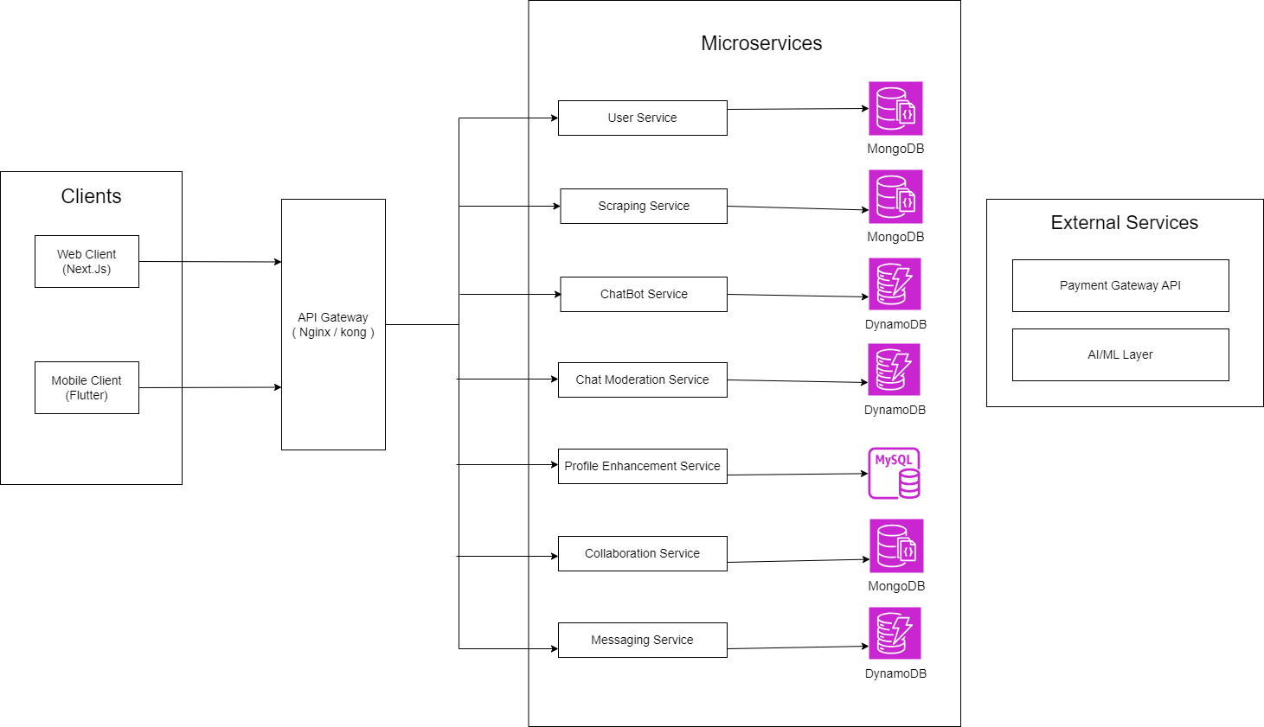
Methodology – Architecture Diagram (Tentative)

Slide 6
Outcome of the Project
The outcome of the project will be ALMABRIDGE. An innovative Alumni-Student Connect Platform, designed to bridge the gap between current students and alumni, facilitating meaningful interactions and mentorship opportunities. This platform, available as a web application initially, will cater to university and department-level connections, offering a suite of advanced features that leverage cutting-edge technologies. The details are as follows:
Features:
Key Performance Indicators:
Real-Time/Live Scraping
AI-Powered Mentorship Matchmaking
Chatbots and Virtual Assistants
AI-Powered Chat Moderation
AI-Powered Project Collaborations
NLP-Based Profile Enhancement
Rewarding System for Alumni
User Engagement: Number of active users on the platform.
Scraping Accuracy: Percentage accuracy of the real-time/live scraping feature.
AI Matchmaking Effectiveness: Success rate of AI-powered mentorship matches.
Response Time: Average response time of chatbots and virtual assistants.
User Satisfaction: User satisfaction score based on surveys or feedback
System Uptime: Percentage of time the web apps are operational.

Slide 7
Plans of Commercialization and Research Disseminations
Market Research and Targeting
Online Presence
Identify target universities in Pakistan, both public and private. Segment by size, reputation, and alumni engagement. Tailor messaging to ensure relevance and higher engagement.
A professional website with clear calls to action. Use LinkedIn, Facebook, and Twitter to engage potential clients. Send newsletters to university contacts and attend conferences for visibility.
Sales and Distribution Strategy
Pricing Model
Use personalized email campaigns targeting university administration and alumni offices. Host webinars to showcase features. Form partnerships with consultants and attend fairs and conferences.
Offer tiered subscription plans (basic, premium, enterprise) for different budgets. Provide a freemium model with a free basic version and upgrade options for advanced features.
Value Proposition and Messaging
Product Development and Refinement
To bridge the gap between students and alumni, fostering valuable networking and career opportunities. Use clear messaging and success stories to build credibility and show impact.
Collaborate with select universities for pilot testing and gather feedback. Ensure the software is user-friendly for students and alumni. Continuously improve based on feedback to enhance usability.

